Slide 1

Tableau for the Business User
Desktop I
2020.3

Slide 2


Welcome to Tableau Training
Kristy McGee
Strategic Technology Services
Center for Enterprise Data and Analytics
kristy.mcgee@tn.gov

Slide 3
Let’s Learn About You
Student Introductions
Name
Role
Experience with Tableau
Anything specific you are hoping to learn?
What do you do for fun?
What is your favorite vacation spot and why?

Slide 4
Class Agenda
Day 1
Introduction to Tableau Desktop
Connecting to and Modifying Data Sources
Filters and Sorting
Creating Groups and Hierarchies
Understanding Dates

Slide 5
Class Agenda
Day 2 Charts
Show Me
Text Tables & Alternatives
Bar Charts
Line Graphs and Time Series Analysis
Multiple Measures in a View
Scatter Plots
Mapping

Slide 6
Class Agenda
Day 3
Connecting Multiple Data Sources
Data Manipulation and Extracts
Basic Calculations
Quick Table Calculations
Level of Detail Expressions
Using Reference Lines and Bands
Parameters and Sets

Slide 7
Class Agenda
Day 4
Introduction to Dashboards
Parameter, Set, and Dashboard Actions
Containers
Story Points
Visualization Best Practices
Review

Slide 8
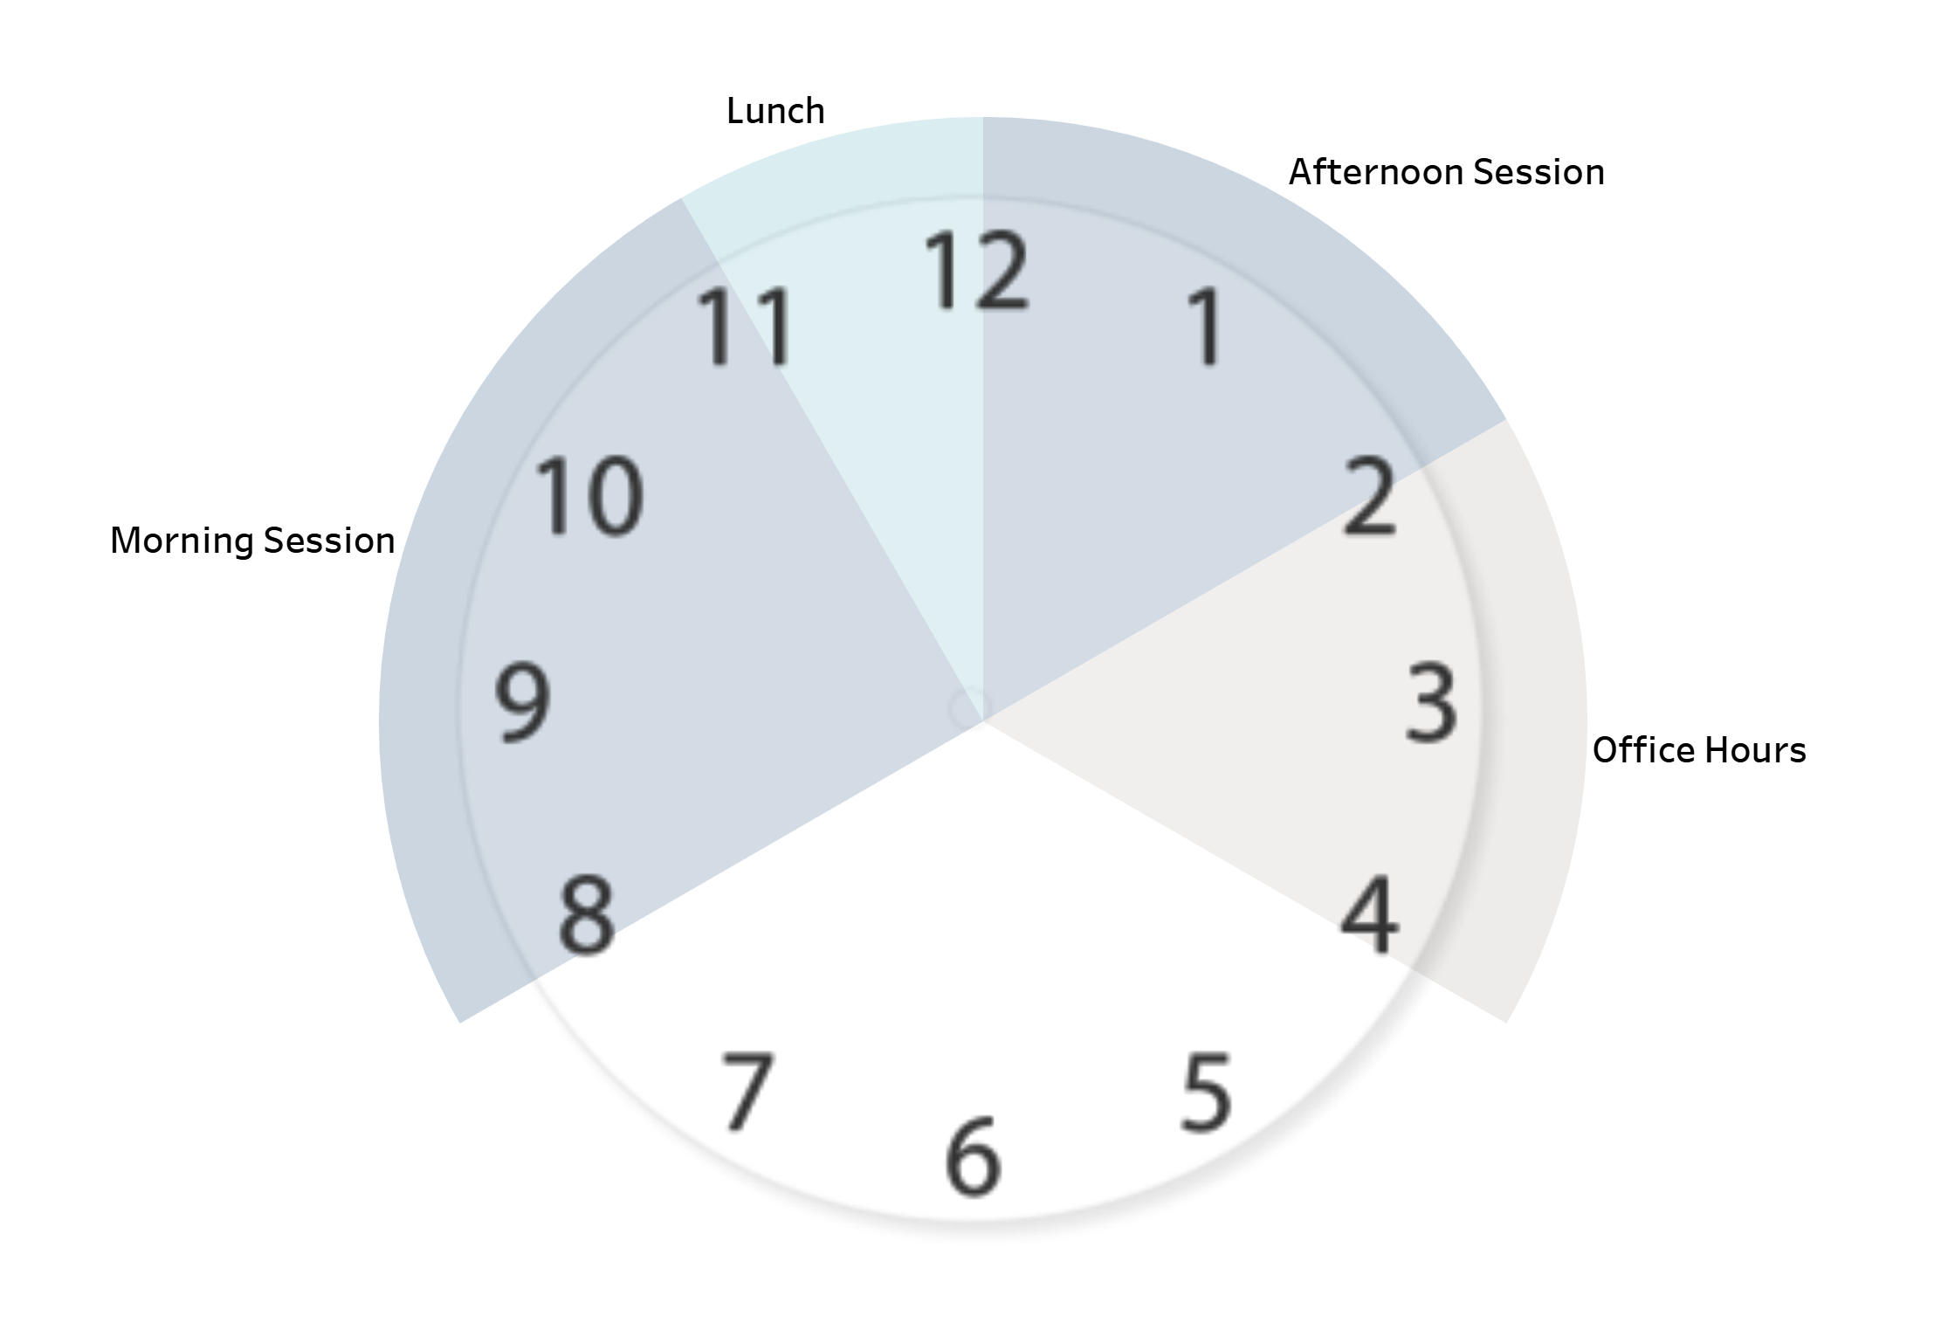
Logistics
Start 8am
Lunch 11am
End 2pm
Office Hours 2pm-4pm
Yes, this is Tableau

Slide 9
Class Structure
Topic Introduction
Discussion
Demo
Practice
Review

Slide 10
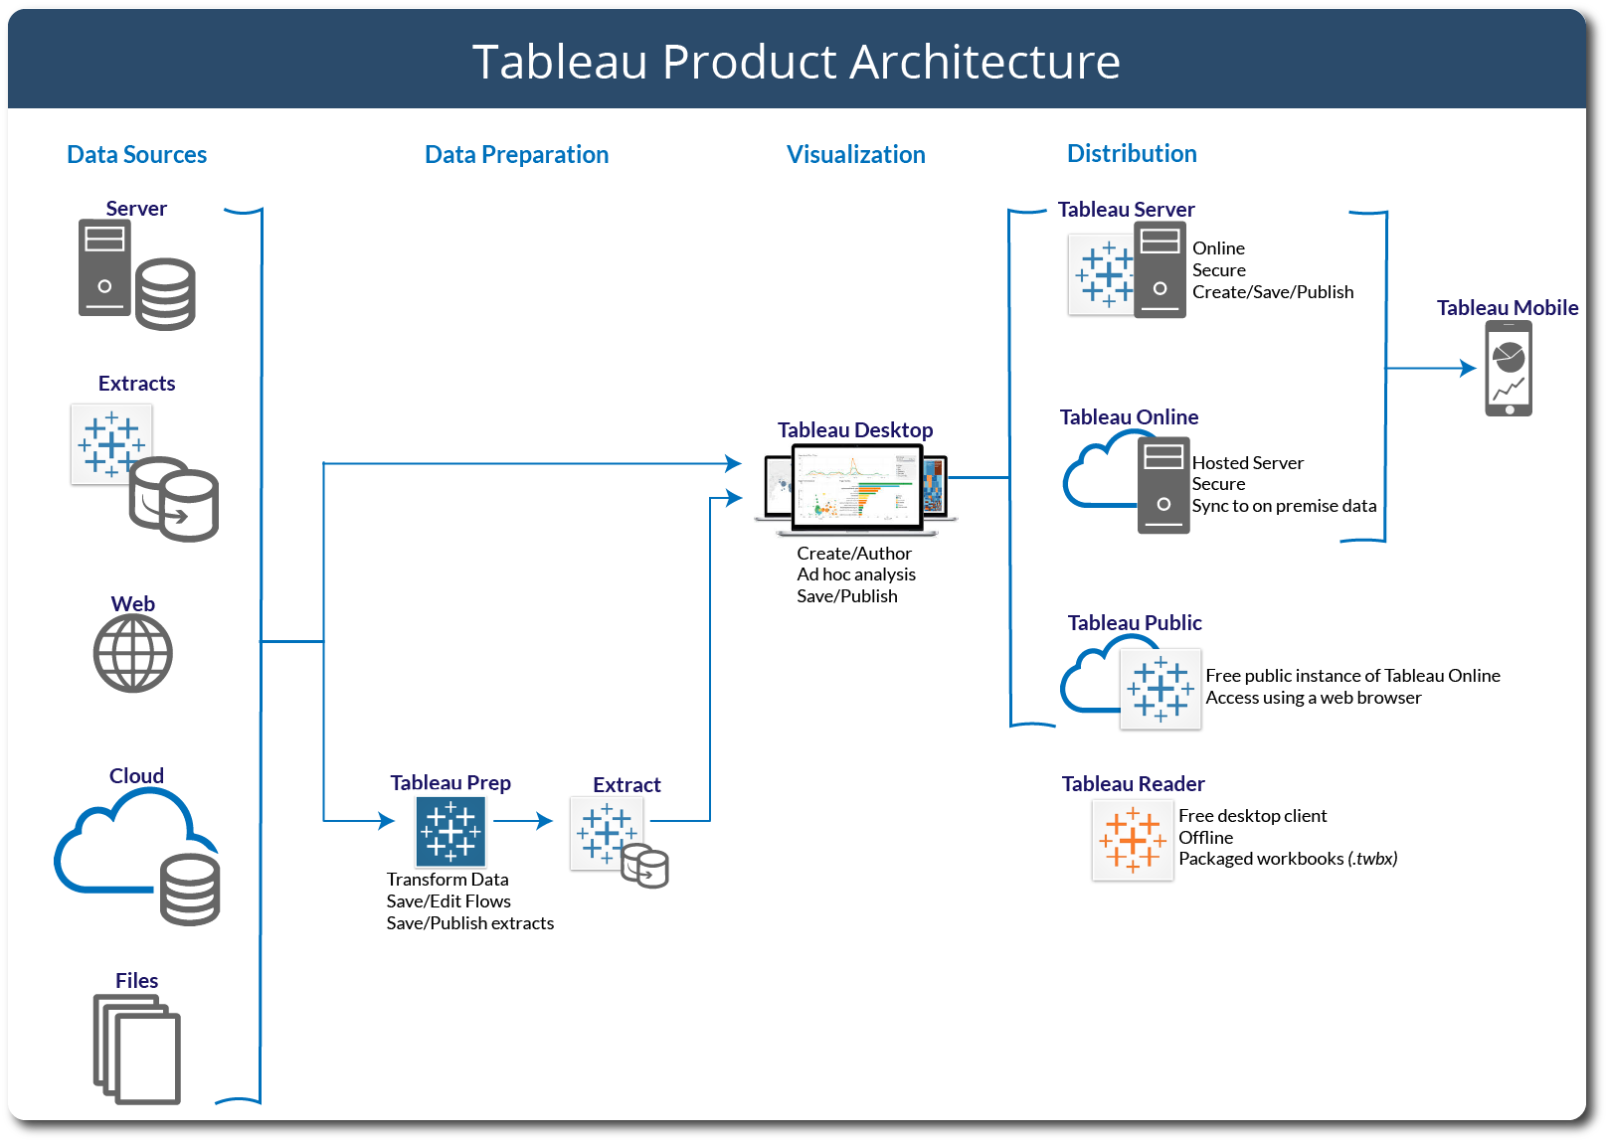

Slide 11
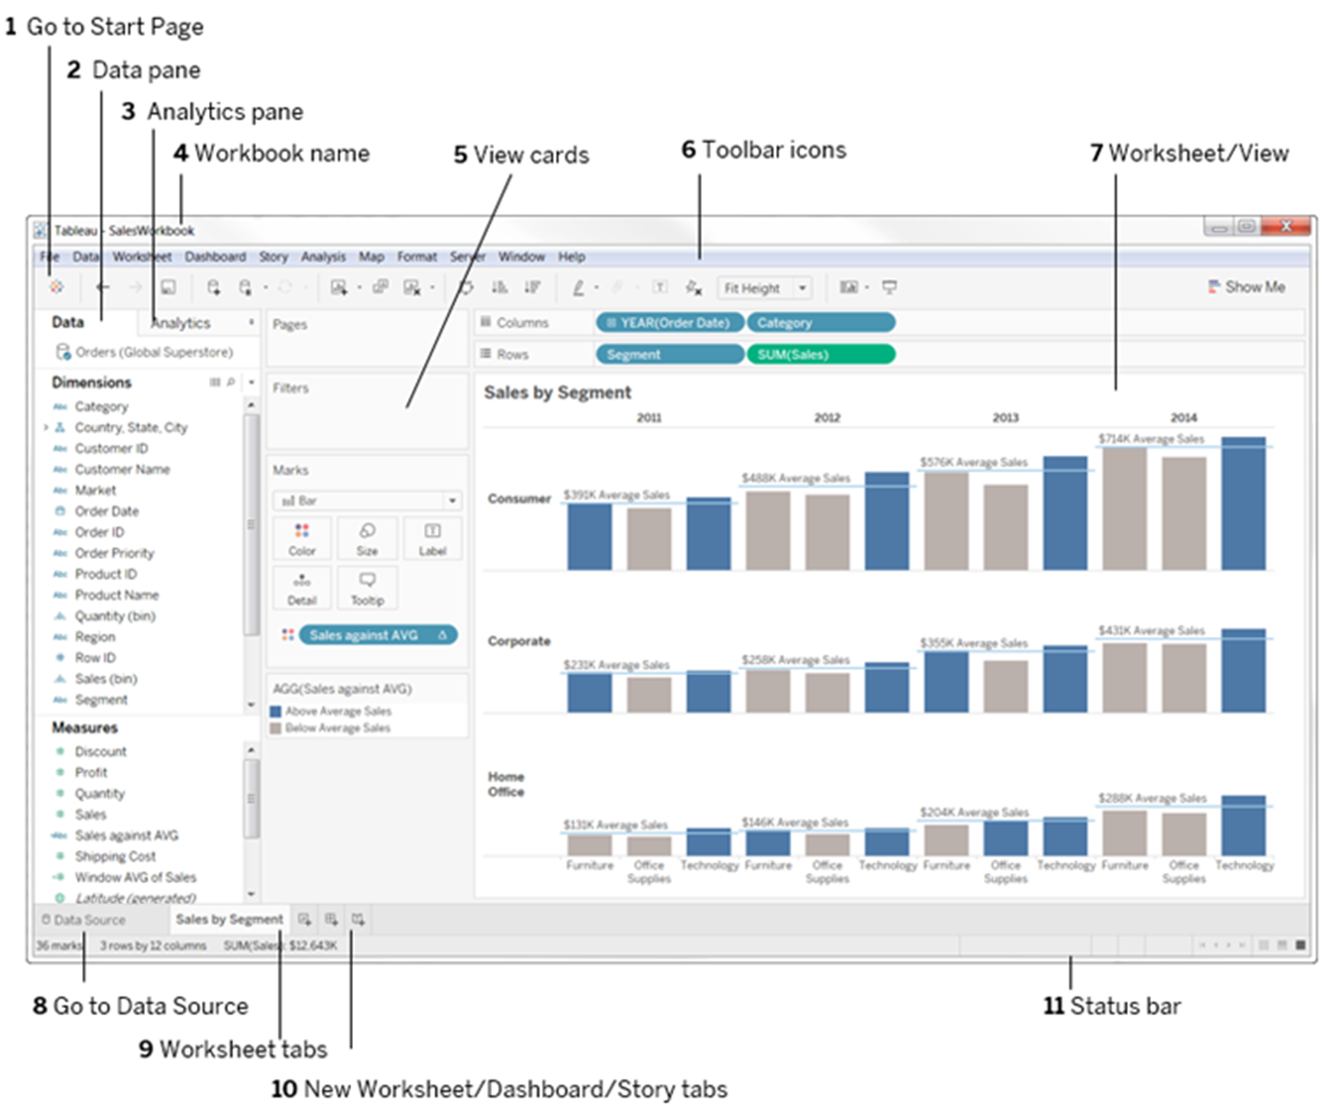
Application Terminology

Slide 12
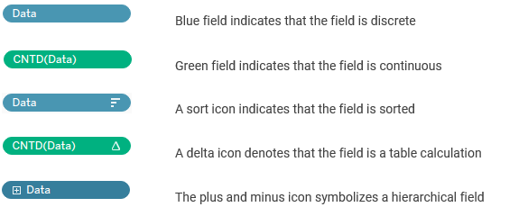
Visual Cues

Slide 13
File Types
File Type and Extension | Description
Tableau workbooks (.twb) | Contain one or more worksheets and dashboards, and always refer to data outside of the workbook itself.
Tableau Packaged Workbooks (.twbx) | Contain a workbook along with any supporting local file data sources and background images. This format is the best way to package your work for sharing with others who don’t have access to the data.
Tableau Data Extract files (.hyper or legacy .tde) | Local copy of an entire data source or a subset that you can use to share data or work offline and improve performance and efficiency.
Tableau Data Connection (.tds) files | The underlying data and store metadata (that is, any data customizations you have made in the workbook, such as groups, comments, sets, and so forth) related to the data source. Also serves as a short cut for quickly connecting to data sources you use often.

Slide 14
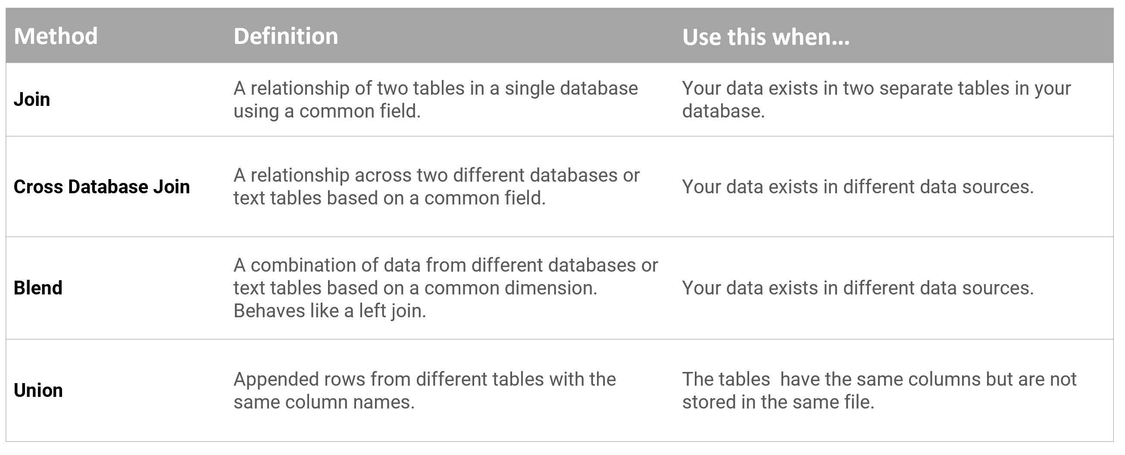
Data Connection Options

Slide 15
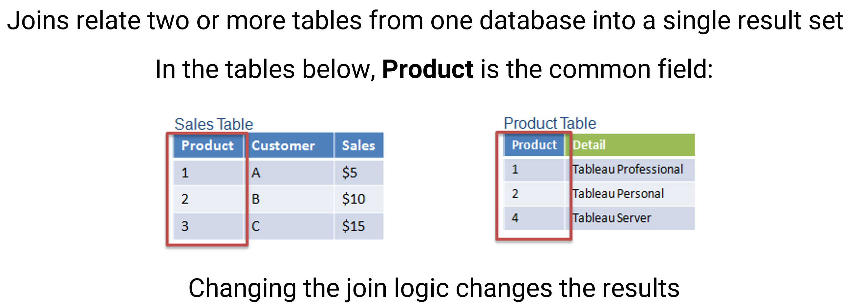
Joins

Slide 16
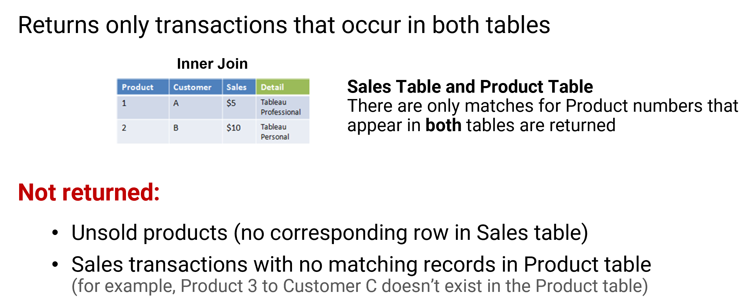
Inner Join

Slide 17
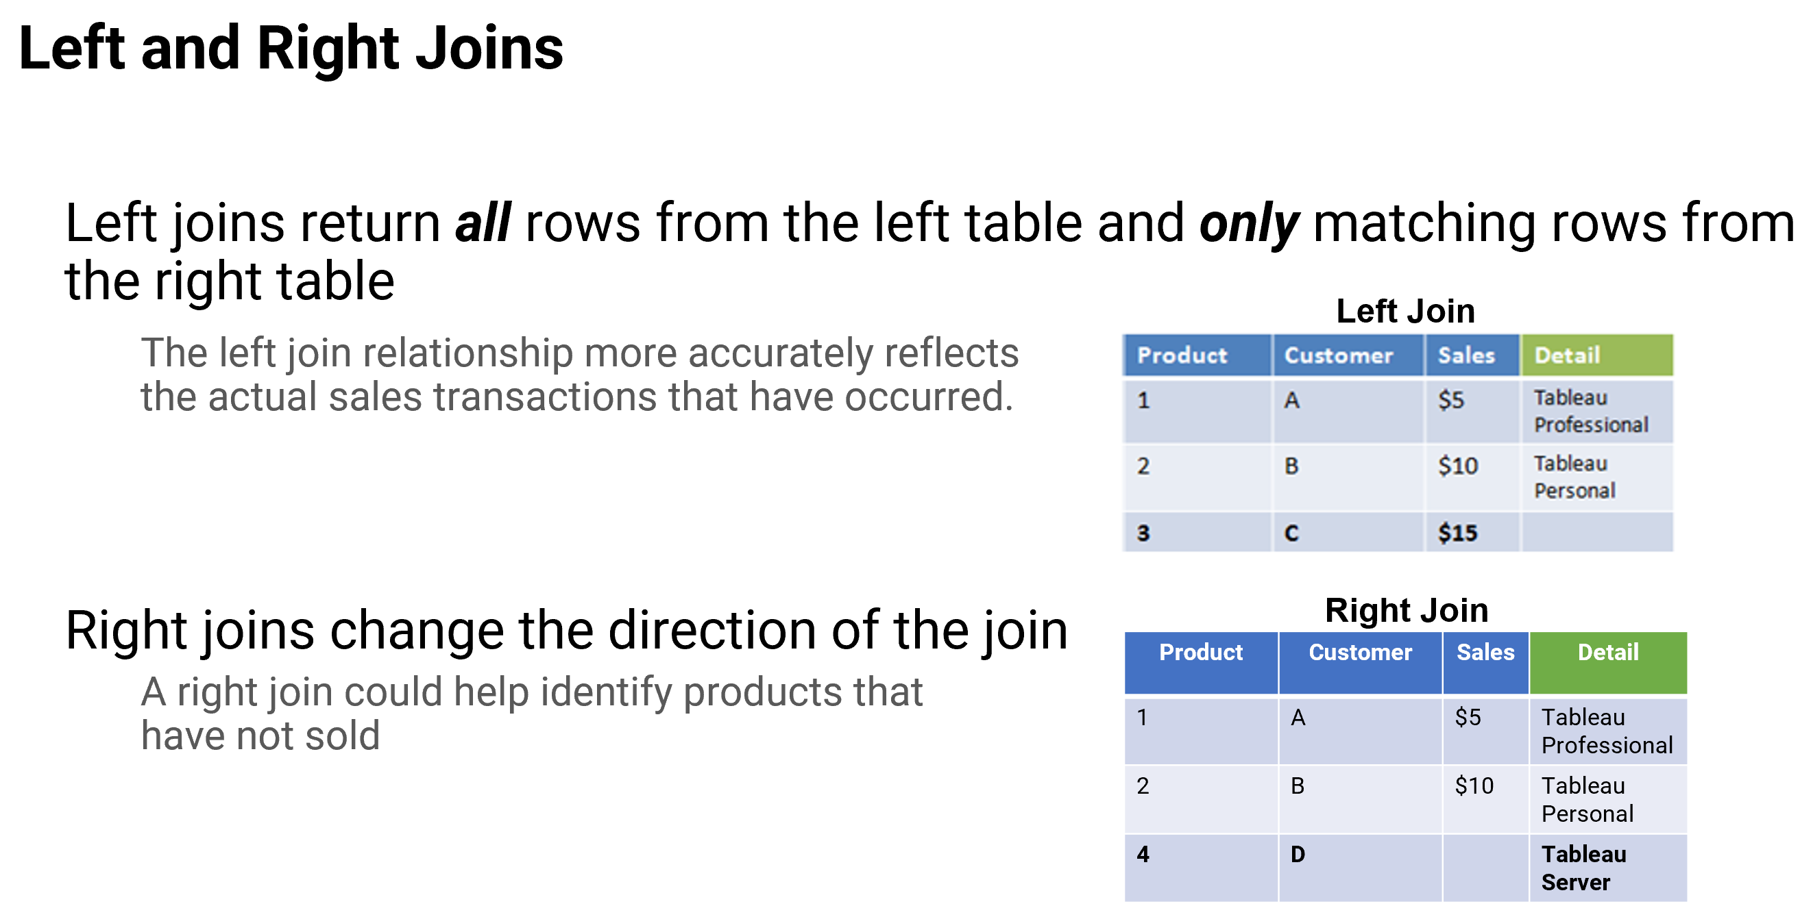
Left and Right Joins

Slide 18
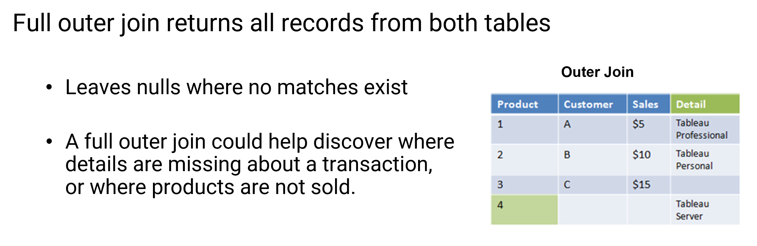
Full Outer Joins

Slide 19
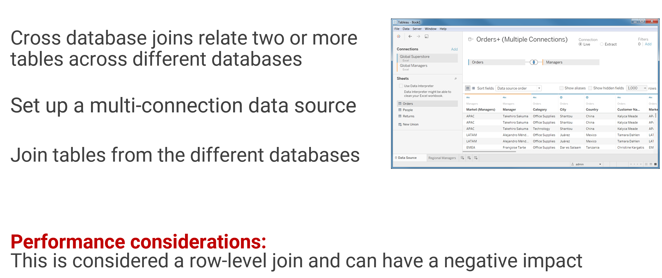
Cross Database Joins

Slide 20
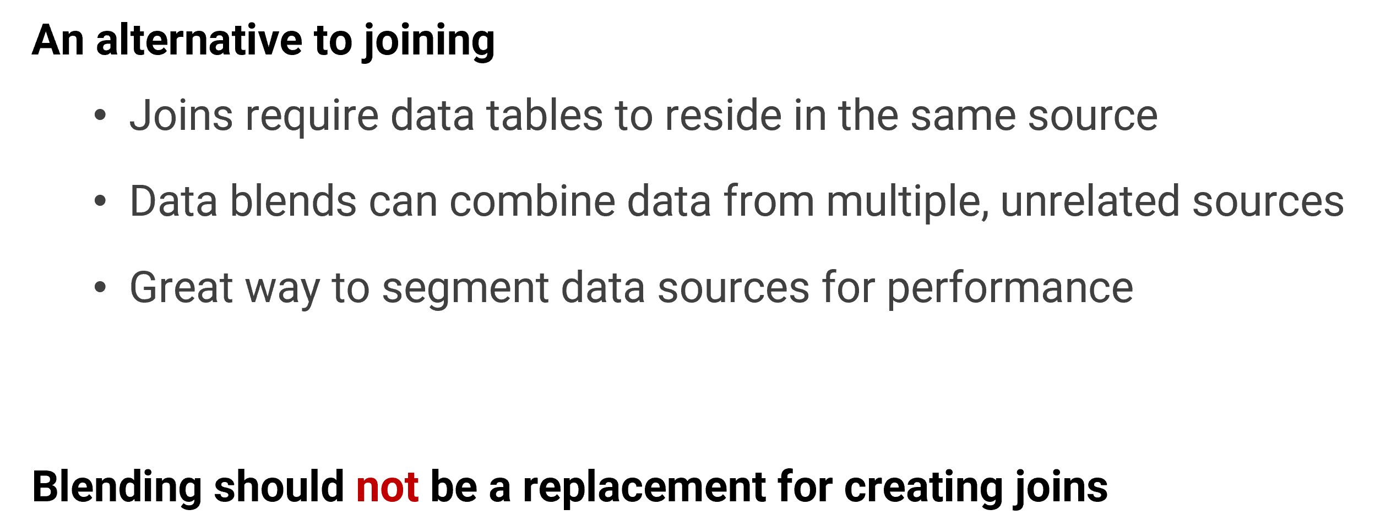
Data Blending

Slide 21
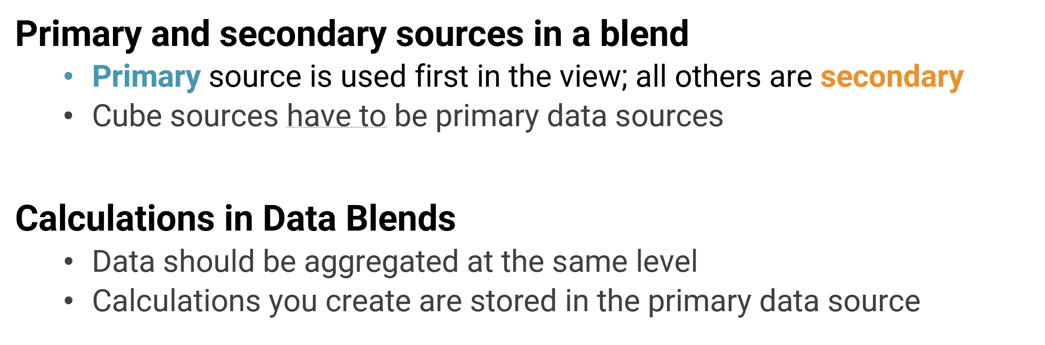
Data Blending

Slide 22
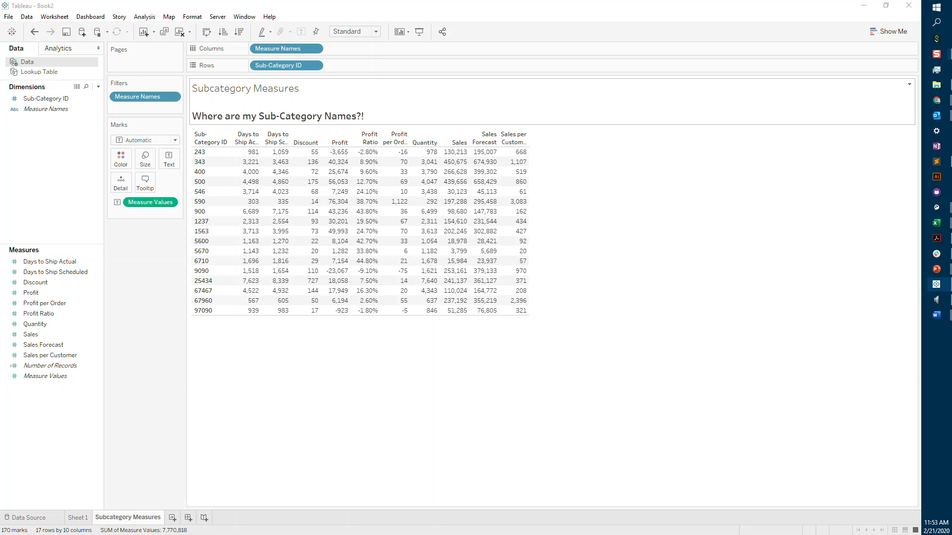
Use Case – Editing Primary Aliases

Slide 23
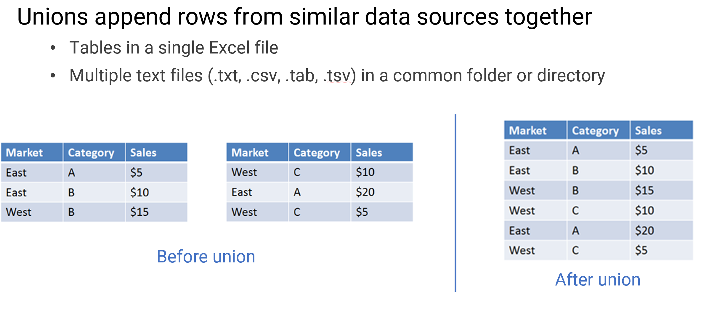
Unions

Slide 24
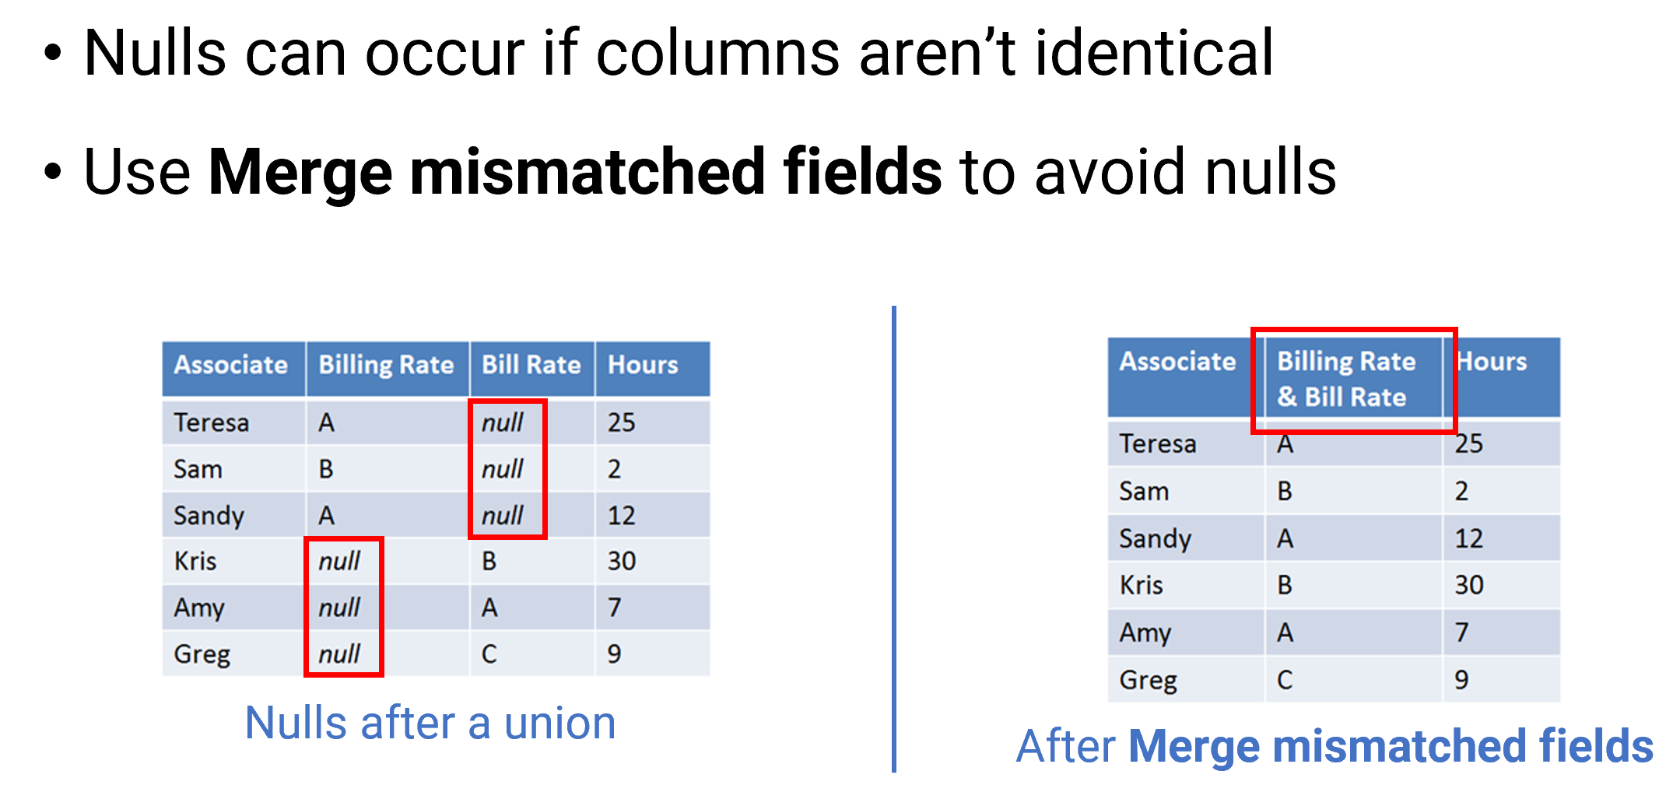
Merge Fields

Slide 25
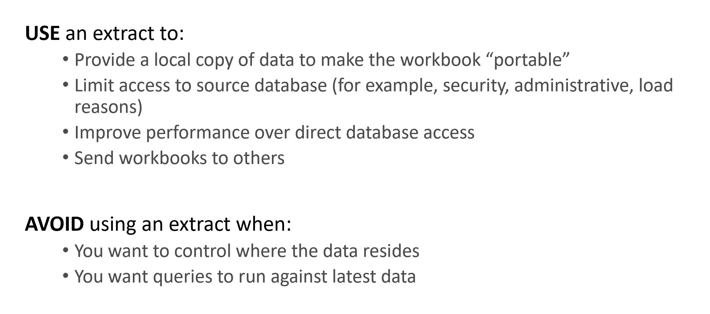
Using Data Extracts

Slide 26
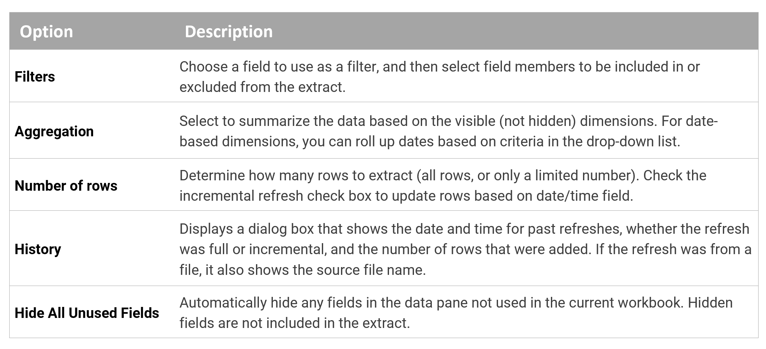
Extract Configuration

Slide 27
Calculations

Slide 28
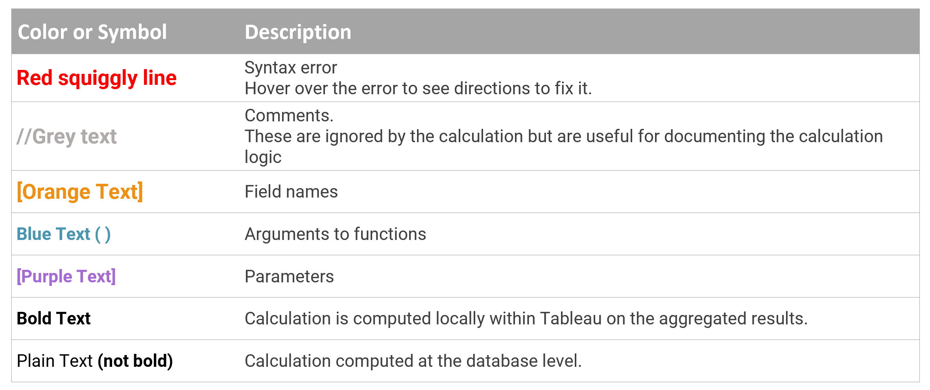
Formula Editing Conventions

Slide 29
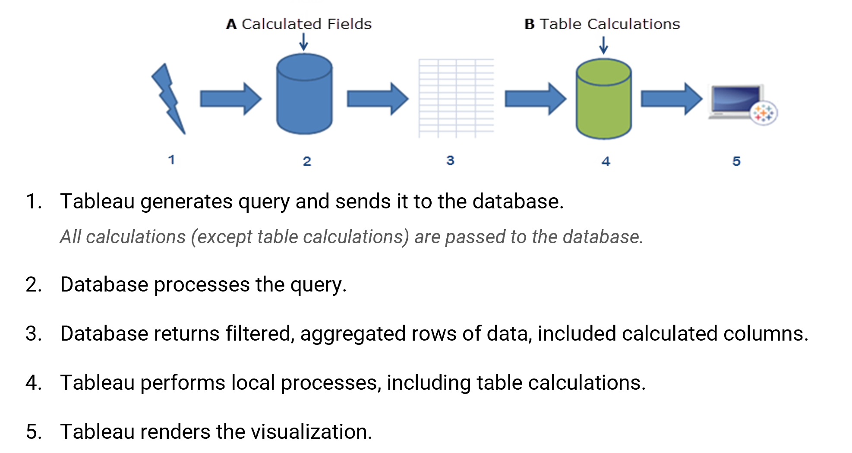
Understanding Where Calculations Occur

Slide 30
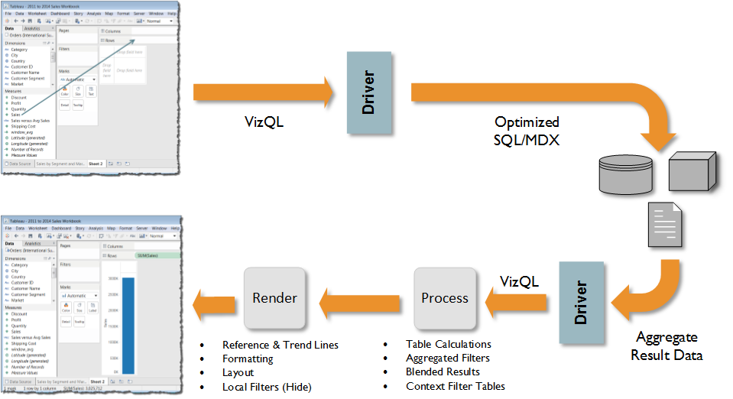
Desktop Architecture

Slide 31
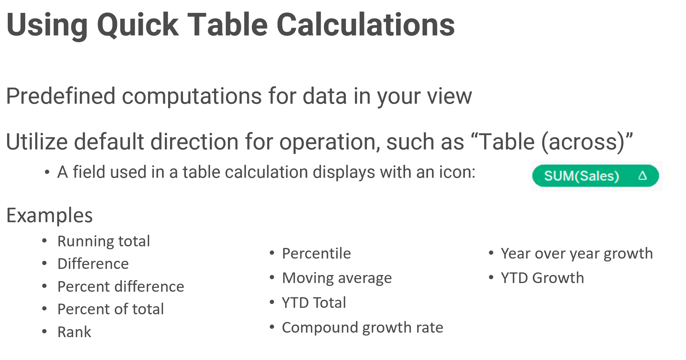
Using Quick Table Calculations

Slide 32
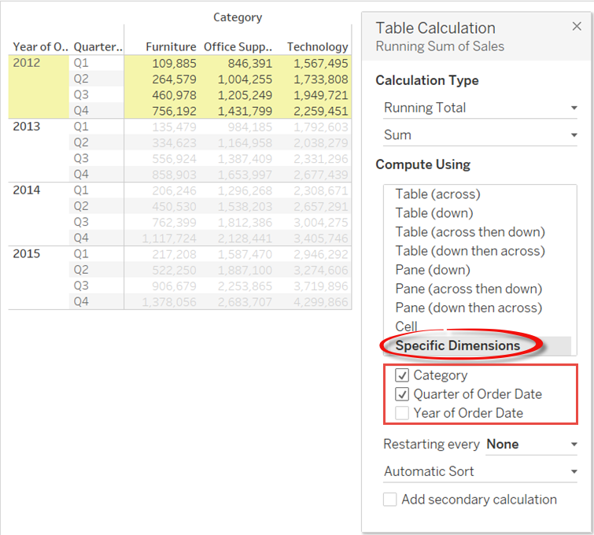
How to Translate Table Calculations
Start from the bottom and read up
For every:
Category and Quarter of Order Date
Calculate the Running Total Sum
by Year of Order Date
2
1
2
1
3
3

Slide 33
Level of Detail Calculations (LOD)
Level of detail refers to the granularity or aggregation of the data in your view
LOD calculations:
More precise control over the granularity or aggregation levels shown in your view
Useful for looking at data that might otherwise be misleading when aggregated
Use for: https://www.tableau.com/about/blog/LOD-expressions
Cohort Analysis
Totals and averages across segment
Aggregates of aggregates
Binning aggregates

Slide 34
LOD Syntax and Calculation Types
Syntax structure:
{Keyword [Column1], [Column2], [ColumnN]: Aggregate Expression}
For example: {FIXED [State]:SUM([Sales])}
Keyword | Description | Example
FIXED | Allows you to specify the aggregation or granularity independent of the fields used in the level of detail of the visualization. | AVG({FIXED [State]:SUM([Sales])}) Total sales for each state, averaged across all states.
INCLUDE | Calculates results at a level less aggregated than the visualization's level of detail. | {INCLUDE [City]:SUM([Sales])} Sum of Sales, including the City level of detail.
EXCLUDE | Calculates results at a level more aggregated than the visualization's level of detail. | {EXCLUDE [City]:SUM([Sales])} Sum of Sales, excluding the City level of detail.

Slide 35
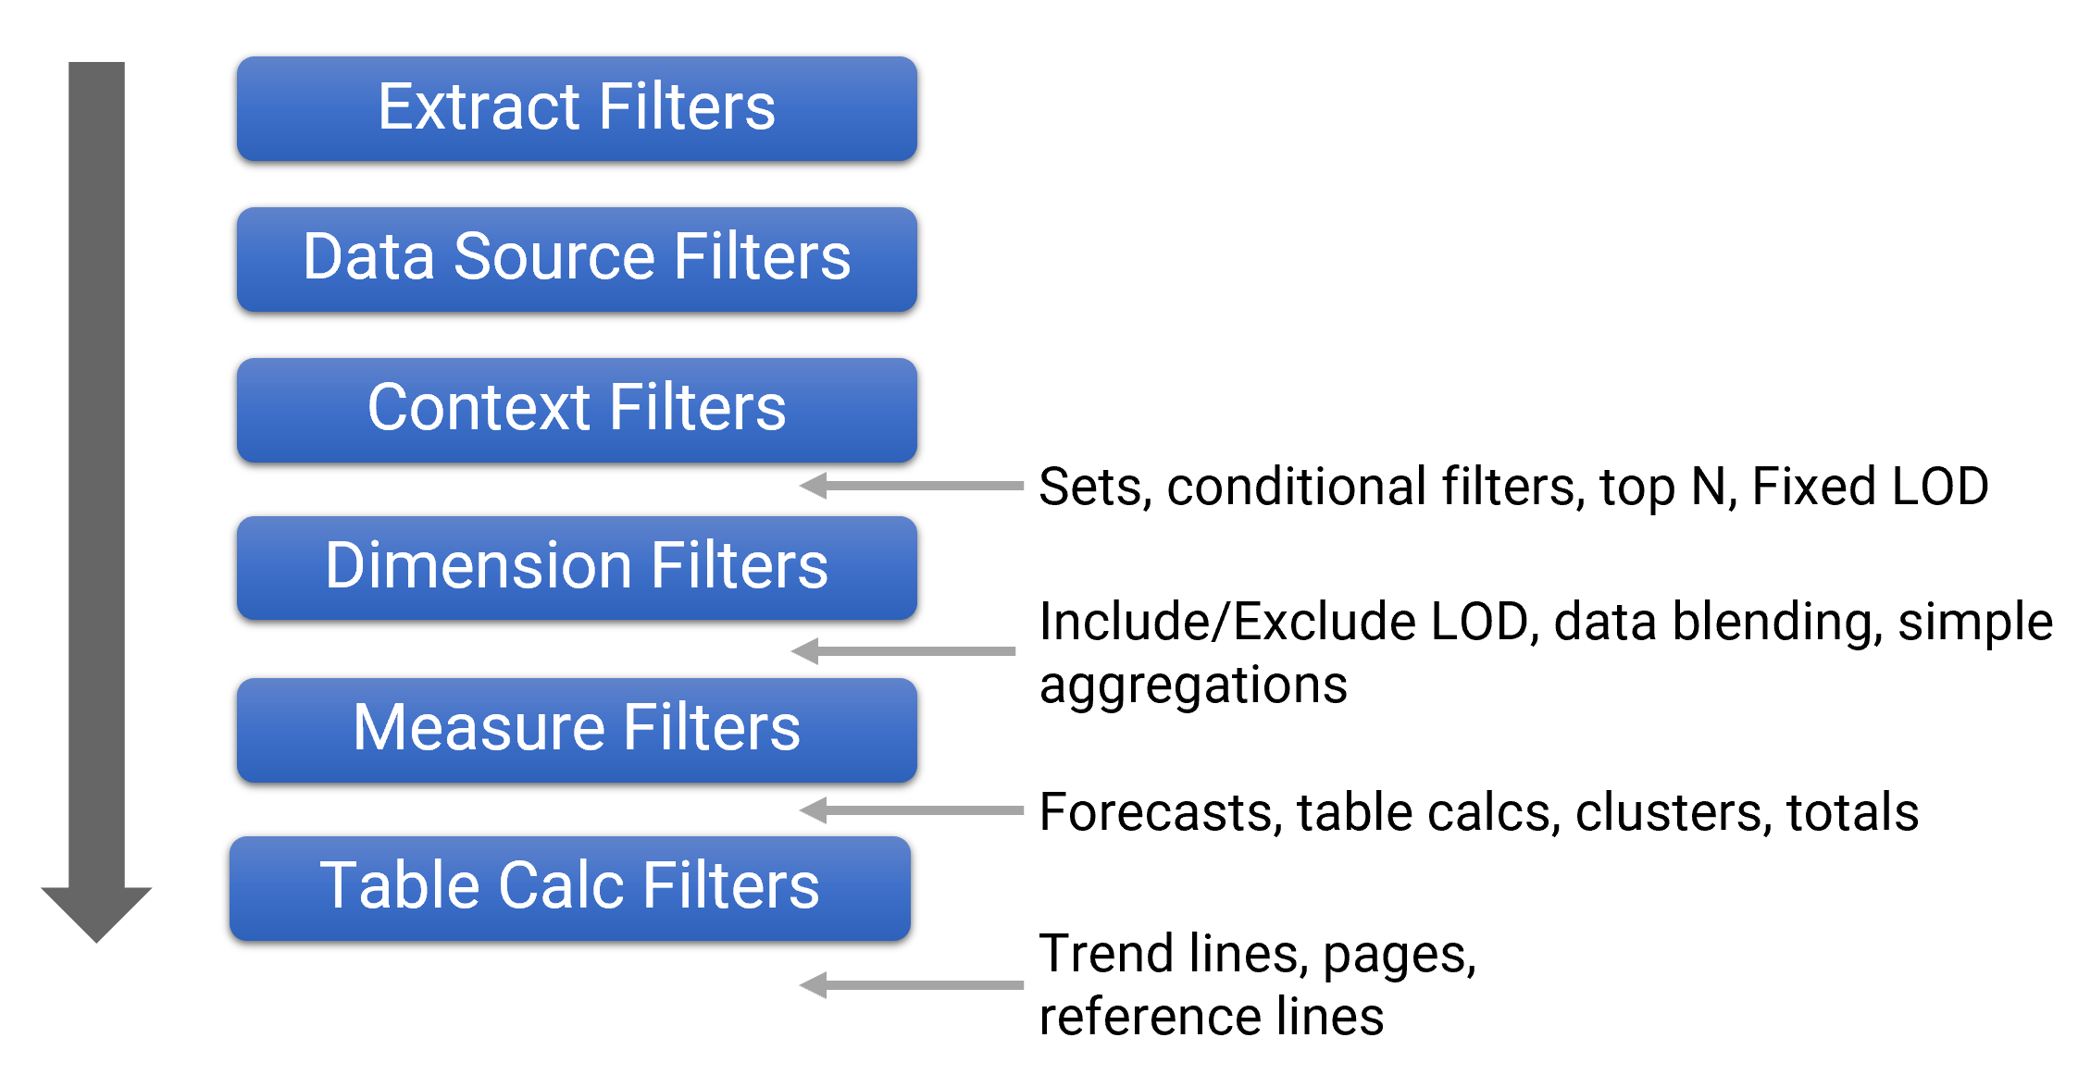
Order of Operations (Query Pipeline)

Slide 36
Parameters

Slide 37

Parameters
Parameters can give the audience the ability to explore your data with more flexibility. They are stored with the workbook, not a specific data source or worksheet --- so the parameter can be used across several disparate sources.
Mind Blown!

Slide 38
Parameters
Parameters can give the audience the ability to explore their data and visualizations in many ways:
Setting values for filters
User controlled thresholds
What-if scenarios
Dynamic fields, axes, titles,
Filtering across different data sources
Top/Bottom N

Slide 39
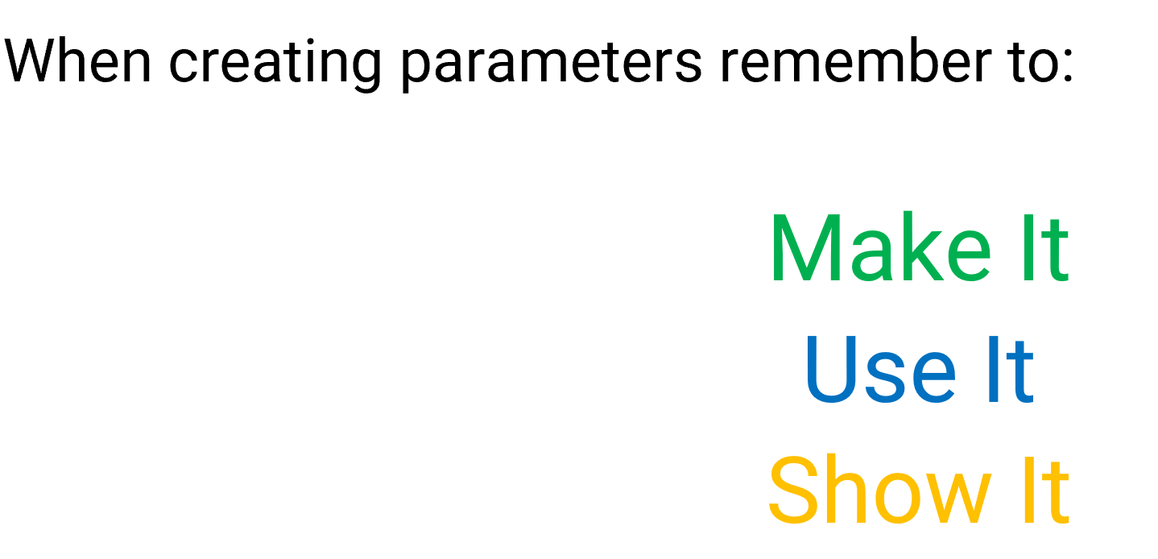
Parameters

Slide 40
Putting It All Together
Dashboards

Slide 41
What is a Dashboard?
A dashboard is a visual display of the most important information needed to achieve one or more objectives; consolidated and arranged on a single screen so that the information can be monitored at a glance.
- Stephen Few

Slide 42
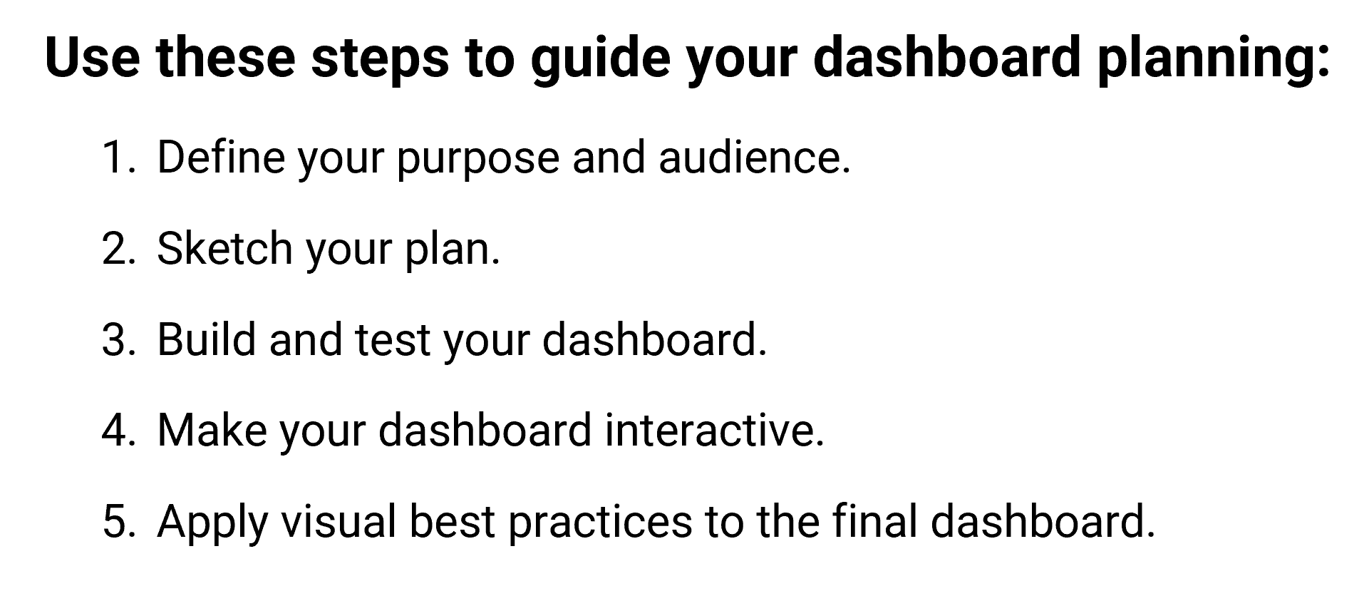
Planning

Slide 43
Define Purpose and Audience
Why are you building this dashboard?
Who is your audience?
I need to | For example
Share data for discovery | Create a dashboard that gives users access to data in a consumable and interactive format that allows them to ask their own data questions.
Provide an overview of information | Develop a monthly sales dashboard that has filters so users can select which data to view.
Draw attention to specific insights about the data | Use dashboards to tell a specific data story about a scientific discovery.
My audience includes | For example
Users looking for specific information (more interactive) | Trainers viewing evaluation scores over time to track performance.
Information consumers (more passive) | Managers and directors who want to know why sales are down in the East region.

Slide 44
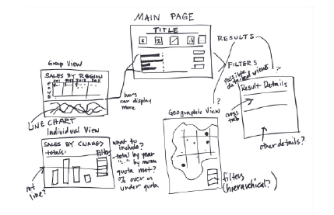
Sketch Your Plan
Which worksheets will you use?
Allow users to drill down from high-level to granular-level detail?
Utilize filters, actions, or parameters for interactivity?
Link to multiple dashboards?

Slide 45
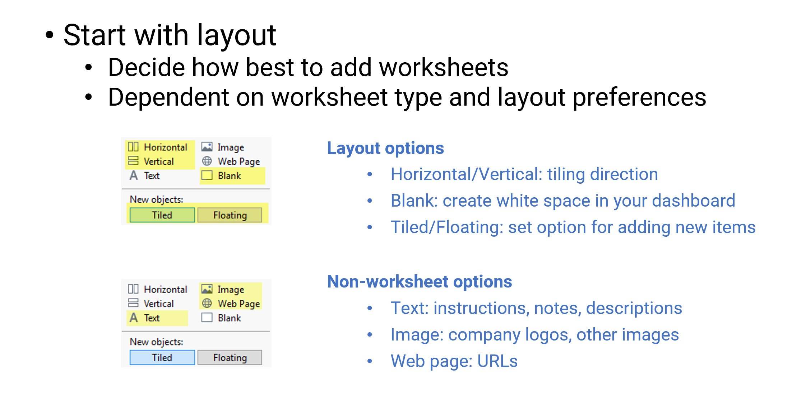
Building Your Dashboard

Slide 46
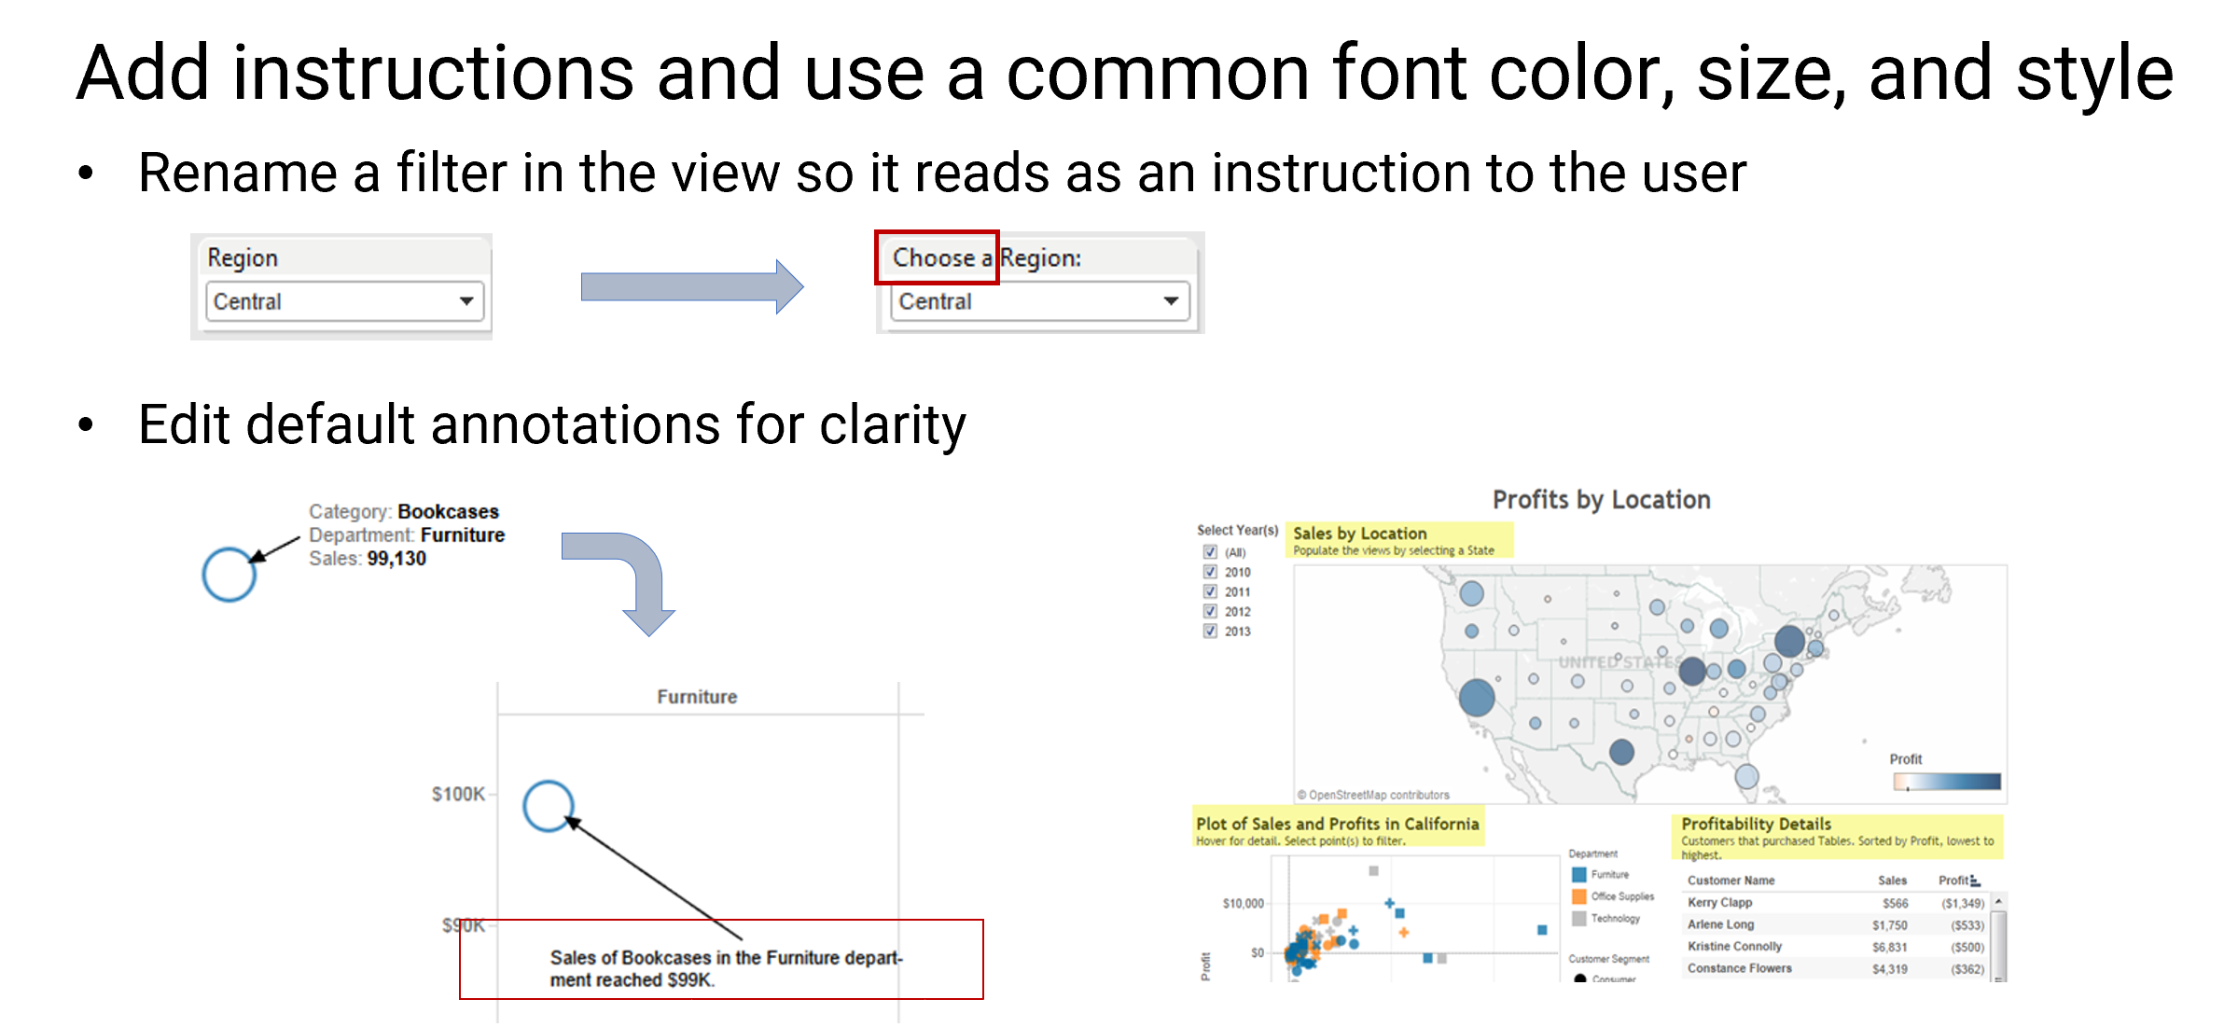
Instructions and Annotations

Slide 47
Visual Best Practices
Color
Limit number of colors used; use brightest for most important data. (Two shades of same hue suggest relationship)
Sizing
Keep users’ screens in mind (Laptops? Tablets? Giant monitors?)
Fonts
Readable? Sized correctly? Keep it simple—let the data do the talking.
Remove extras
Are all those legends necessary?
Titles
Make them useful (to help navigating dashboard); remove if unnecessary.

Slide 48
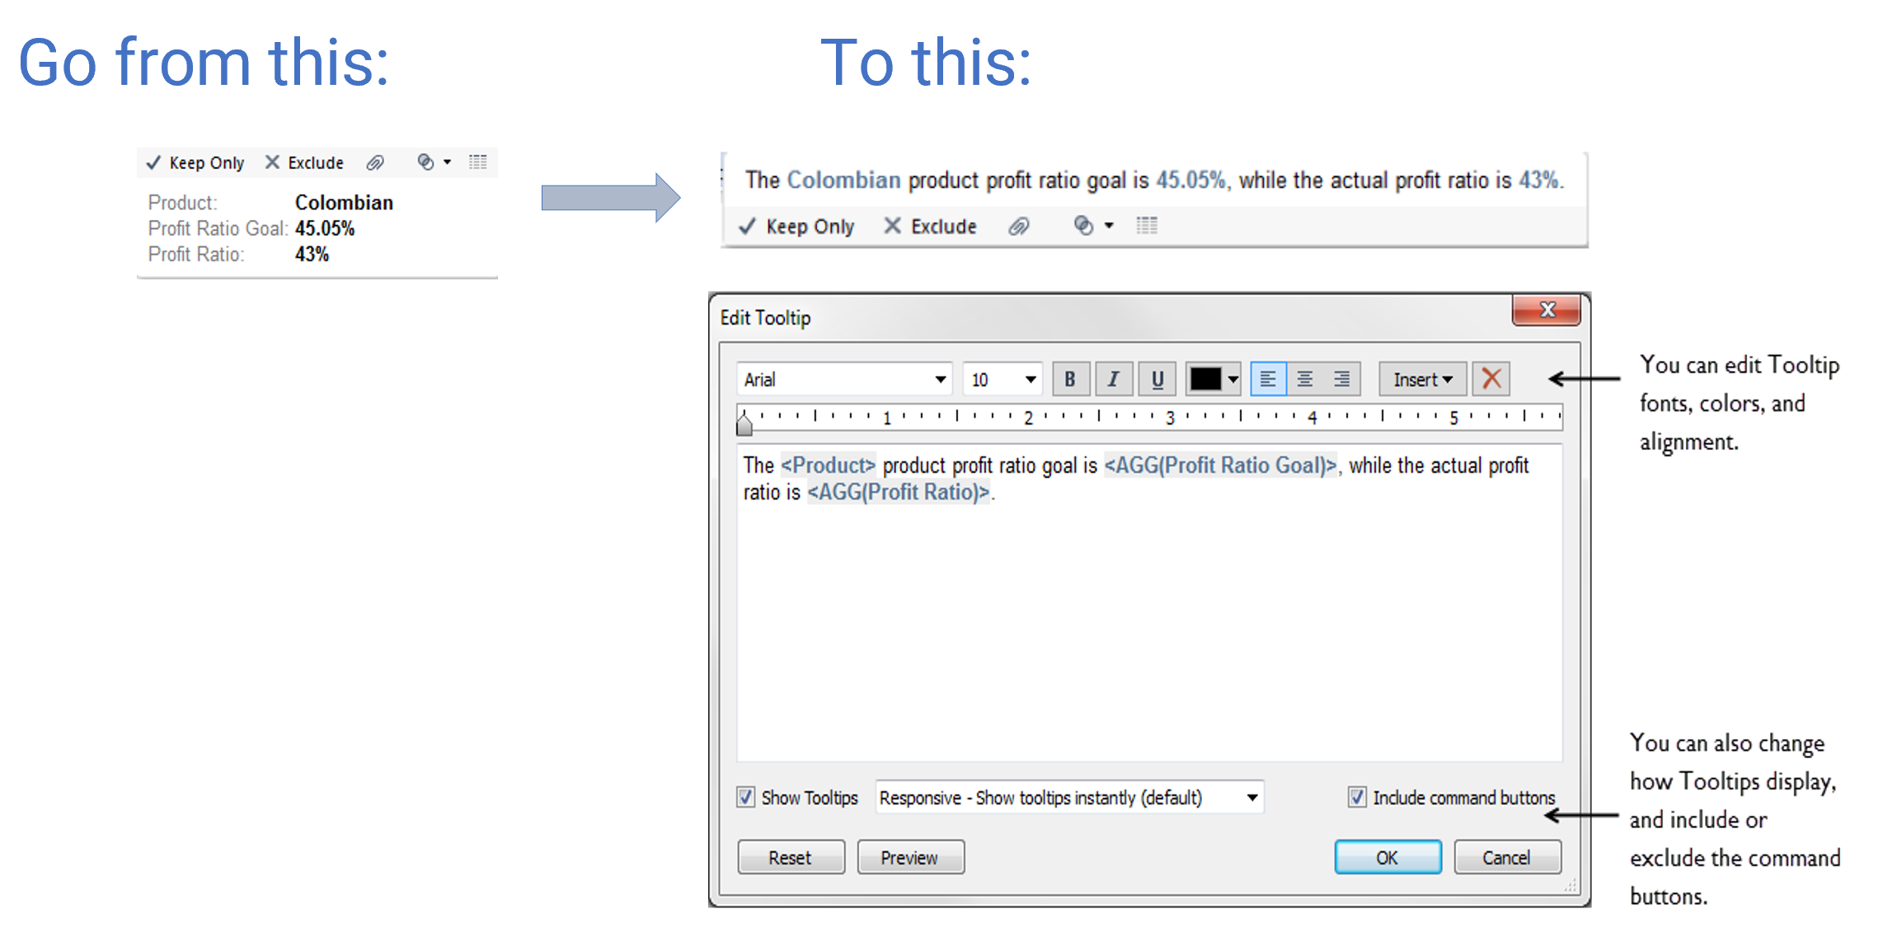
Tooltips

Slide 49
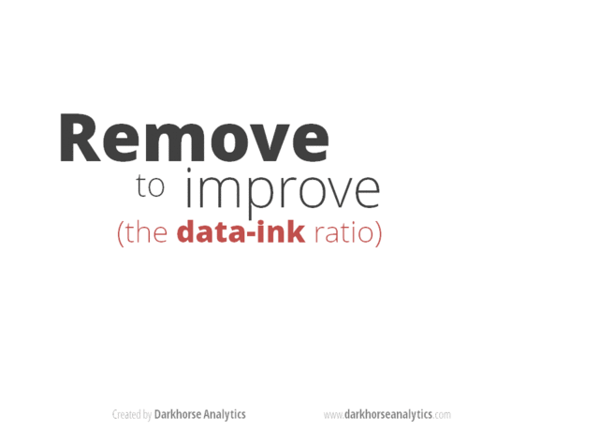
Remove Chart Junk

Slide 50
Remove Chart Junk
What is unclear or cluttered?
Axis values clear and compact?
Appropriate filters?
“Cascading filters” help guide users through filter options.
Dashboard overcrowded with too many worksheets, filters, or legends?
Use multiple dashboards or even individual visualizations with actions between them.
Use the Show/Hide containers to simplify the view.
https://www.tableau.com/about/blog/2017/10/7-tips-and-tricks-dashboard-experts-76821

Slide 51
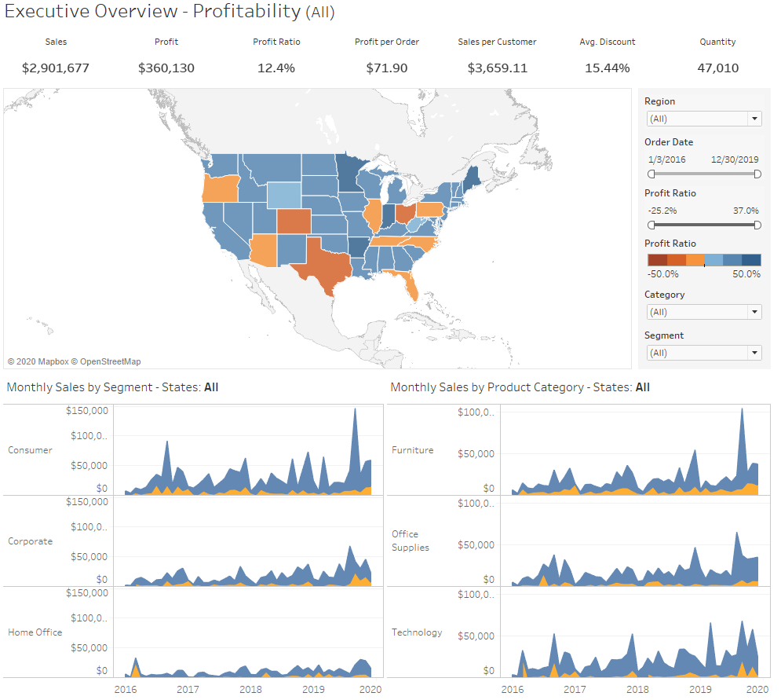
Example
Cluttered

Slide 52
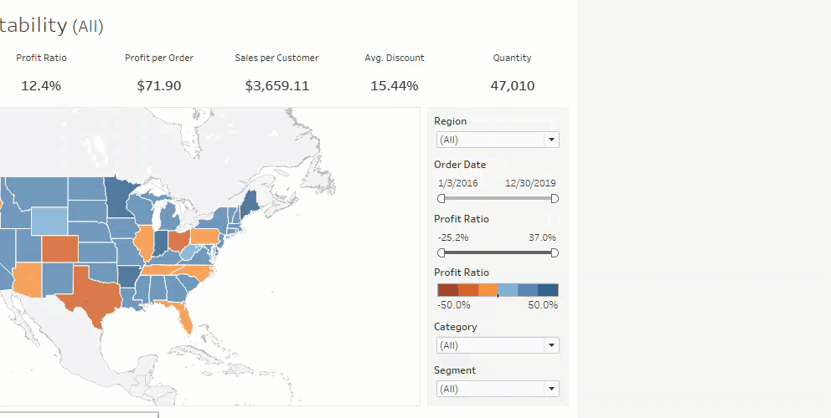
Show/Hide Containers

Slide 53
Improving Performance
Everything in life is better in moderation
Tableau is not faster than your database
If it is slow in Tableau Desktop, it will be slow in Tableau Server

Slide 54
Resources
Support
tableau.com/support
kb.tableau.com
tableau.com/support/help
tableau.com/learn/classroom
https://onlinehelp.tableau.com/current/pro/desktop/en-us/shortcut.html
Calculations: https://community.tableau.com/community/viz-talk/tableau-community-library/twl
SharePoint Excel:
https://kb.tableau.com/articles/howto/connecting-to-sharepoint-based-excel-file
Community
community.tableau.com/welcome
Twitter
Blogs
Tableau User Groups
Makeover Monday/Workout Wednesday
Tableau Conference https://tc19.tableau.com/learn/sessions

